Slide 1
Machine Translation

Slide 2
Introduction
Machine translation is conversion of text from source language to target language.

Slide 3
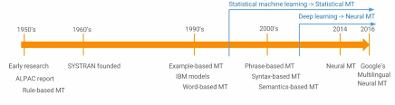

Slide 4
Different techniques
Rule-based
Statistical-based
Neural-based

Slide 5
Typology
English – SVO
Hindi – SOV
Arabic- VSO

Slide 6
Issues
Sometimes, rather than a single word, there is a fixed phrase in the target language; French informatique thus translates to English computer science.
For example, Japanese does not have a word for privacy, and English does not have a word for Japanese oyakoko (we make do with filial piety).

Slide 7
Rule based Machine Translation
Syntax and Phrase are used to translate source text into target text.
For example, Apertium

Slide 8
Statistical based Machine Translation
Probability and Bayes theorem are used to translate text. It depends on the size of dataset which is used for training.
For example, Google translate (from 2010 to 2016)

Slide 9
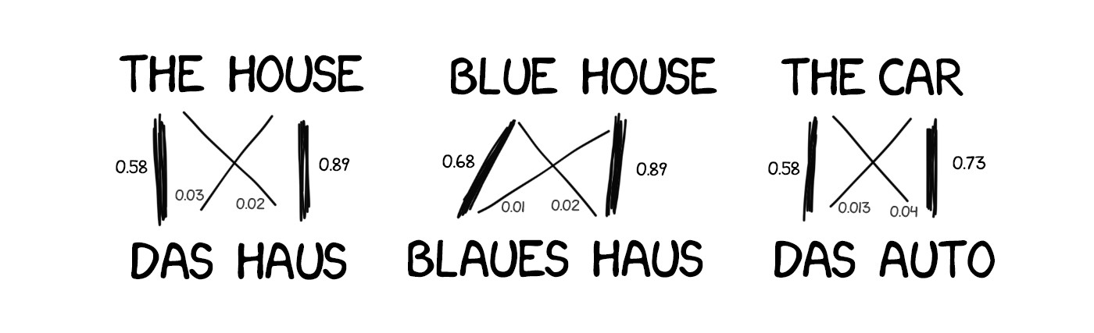

Slide 10
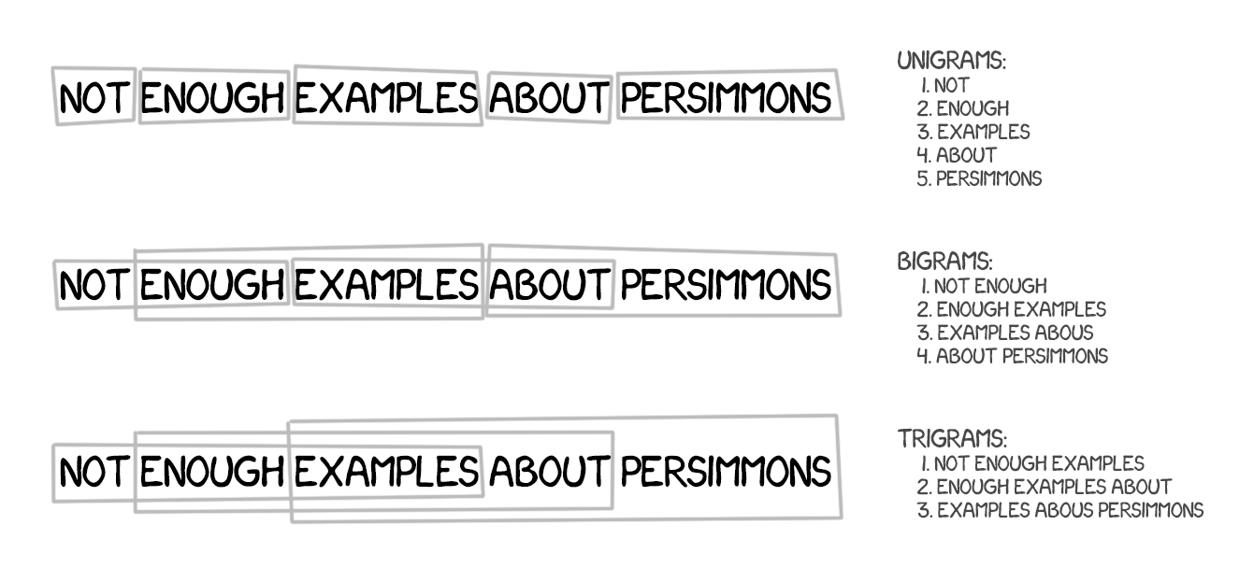

Slide 11
Neural network based Machine Translation
Neural network models such as LSTM is used to translate source text to target text. For example, Google translate (from 2016).

Slide 12
Example
Wagen can be translated into:
  Vehicle : 5000 : 0.5
  Car : 3000 : 0.3
  Coach : 1500 : 0.15
  Wagon : 500 : 0.05

Slide 13
Phases
Analysis
Transfer
Generation

Slide 14
Parallel corpus
English | German
Diverging opinions about planned tax reform | Unterschiedliche Meinungen zur geplanten Steuerreform
The FDP economics expert , Graf Lambsdorff , today came out in favor of advancing the enactment of significant parts of the overhaul , currently planned for 1999 . | Der FDP - Wirtschaftsexperte Graf Lambsdorff sprach sich heute dafuer aus , wesentliche Teile der fuer 1999 geplanten Reform vorzuziehen .

Slide 15
English- Subject Verb Object
Hindi- Subject Object verb
Word Sense

Slide 16
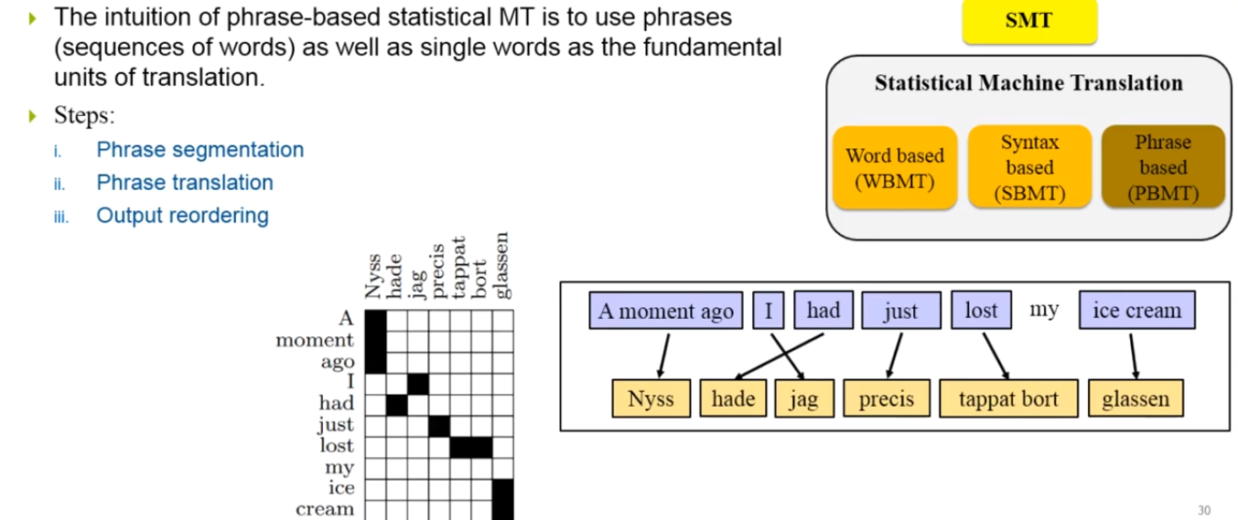
Statistical Machine Translation

Slide 17
For example, French text f is to be translated into English text e. The goal is to maximize the probability P(e|f) i.e. there can be multiple options to translate f text into ei, but max similar text is to be selected.

Slide 18
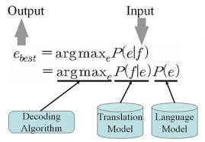

Slide 19
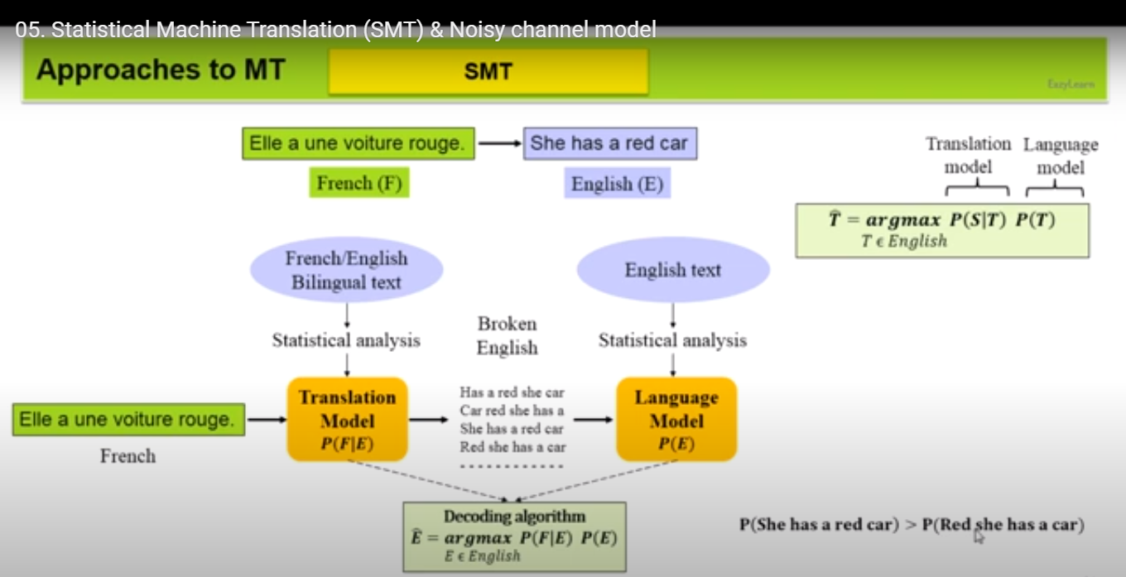

Slide 20
N-gram approach was used before 2005.

Slide 21
Neural machine translation
Translating out-of-domain data
Training a lot of data
Translating unknown words
Handling long sentences

Slide 22
Neural machine translation
RNN
Attention
Transformer

Slide 23
Recurrent Neural Network
RNN model is based on previous terms.

